Slide 1
Joint Management of Urban Wetland Areas in border region Latvia-Lithuania. (Urb-Area)
Project Nr. LLI-472
Interreg V-A Latvia-Lithuania Programme 2014 – 2020
Programme priority: Sustainable and clean environment through cooperation
Programme priority specific objective:
To increase integration and efficiency of environmental resource management
Joint Management of Urban Wetland Areas in border region Latvia-Lithuania.
Urb-Area
www.anyksciai.lt
www.daugavpils.lv

Slide 2
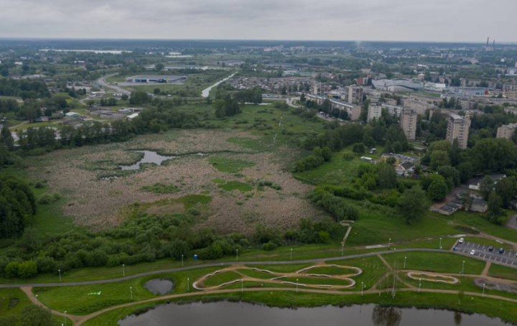
Joint Management of Urban Wetland Areas in border region Latvia-Lithuania. (Urb-Area)
Project Nr. LLI-472
Sustainable and clean environment through cooperation
To increase integration and efficiency of environmental resource management
Preserving biodiversity
Improving ecosystems
URBAN WETLAND
Project goal:
Preserving biodiversity and improving ecosystems of urban wetlands
Wetlands (semi-swamp) are defined as transitional between terrestrial and aquatic eco-systems where the water table is usually at or near the surface or the land is covered by shallow water .
A wetland is a distinct ecosystem that is flooded by water, either permanently or seasonally, where oxygen-free processes prevail. The primary factor that distinguishes wetlands from other land forms or water bodies is the characteristic vegetation of aquatic plants, adapted to the unique hydric soil. Wetlands play a number of functions, including water purification, water storage, processing of carbon and other nutrients, stabilization of shorelines, and support of plants and animals. Wetlands are also considered the most biologically diverse of all ecosystems, serving as home to a wide range of plant and animal life.
www.anyksciai.lt
www.daugavpils.lv

Slide 3
Joint Management of Urban Wetland Areas in border region Latvia-Lithuania. (Urb-Area)
Project Nr. LLI-472
Why wetland’s ecosystem needs to be restored and protected?
Degradation and overgrowing of Daugavpils urban wetland
Open water surface
is shrinking
www.anyksciai.lt
www.daugavpils.lv

Slide 4
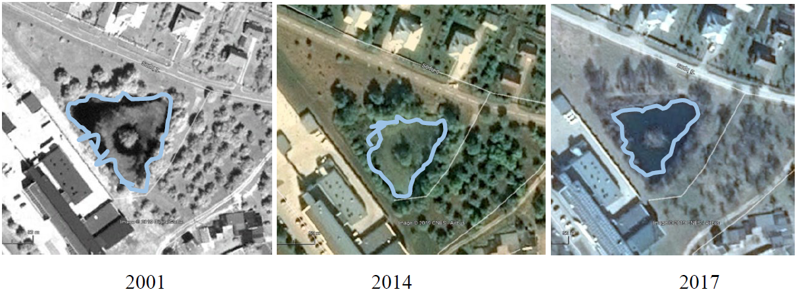
Joint Management of Urban Wetland Areas in border region Latvia-Lithuania. (Urb-Area)
Project Nr. LLI-472
Why wetland’s ecosystem needs to be restored and protected?
Degradation and overgrowing of Anyksciai urban wetland
In rapidly urbanizing areas
due to human activities
wetland’s open water surface is shrinking,
ecosystem get destroyed
www.anyksciai.lt
www.daugavpils.lv

Slide 5
Joint Management of Urban Wetland Areas in border region Latvia-Lithuania. (Urb-Area)
Project Nr. LLI-472
Joint Management of Urban Wetland Areas in border region Latvia-Lithuania / Urb-Area
01.10.2020 – 30.09.2022
24 months
Project budget: 376 140 EUR
Incl. ERDF co-financing 85%: 319 719 EUR
Lead partner: Daugavpils City Council
Daugavpils budget: 266 648 EUR
incl. ERDF co-financing 85%: 226 651 EUR
Partner: Anyksciai district municipality administration
Anyksciai budget: 109 491 EUR
incl. ERDF co-financing 85%: 93 068 EUR
www.anyksciai.lt
www.daugavpils.lv

Slide 6
Joint Management of Urban Wetland Areas in border region Latvia-Lithuania. (Urb-Area)
Project Nr. LLI-472
PROJECT ACTIVITIES
Joint Action Plan Recommendations on management of urban wetlands
Restoration of wetlands’ green infrastructure in Daugavpils and Anyksciai Cleaning of ponds: Latgale Zoo, Green pond
Improvement of wetlands’ adjusted territory Landscaping works in Daugavpils and Anyksciai
Joint on-line management system On-line application for wetland territories, incl. life bird watching cameras and electronic catalogue of wetlands’ biodiversity
Partner workshops, round-table discussions, educational events. Meeting of biologists and responsible municipal specialists, NGO, students
Eco awareness raising Educational activities for children, pupils, general public
Equipment Binoculars, hydroscopes, telescopes
Publicity press releases, articles, municipal webpage, video-clip
www.anyksciai.lt
www.daugavpils.lv

Slide 7
Joint Management of Urban Wetland Areas in border region Latvia-Lithuania. (Urb-Area)
Project Nr. LLI-472
Joint Action Plan Recommendations on management of urban wetlands
Preliminary study in Daugavpils wetland
Joint Action Plan
Endorsement of Joint Action Plan in Daugavpils
Monitoring
Preliminary study in Anyksciai wetland
Endorsement of Joint Action Plan in Anyksciai
10 certified experts from Latvia and 3 experts from Lithuania:
plants, invertebrates, fish, amphibians, reptiles, birds, mammals, wetlands, ponds, invasive species
www.anyksciai.lt
www.daugavpils.lv

Slide 8
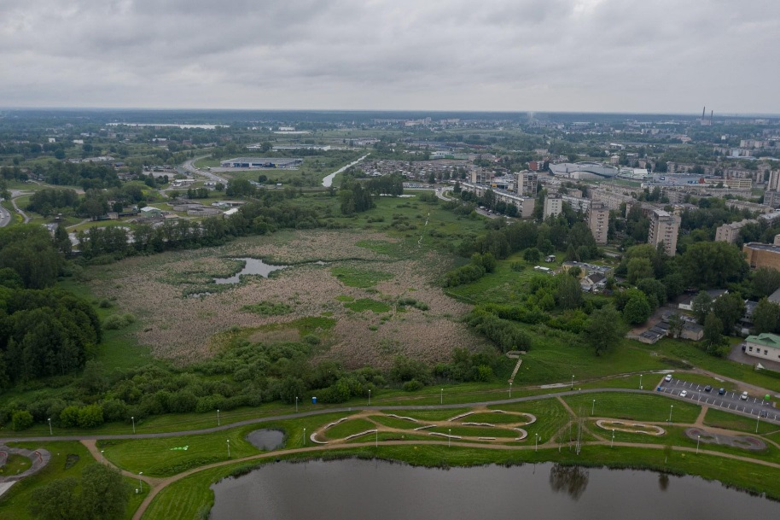
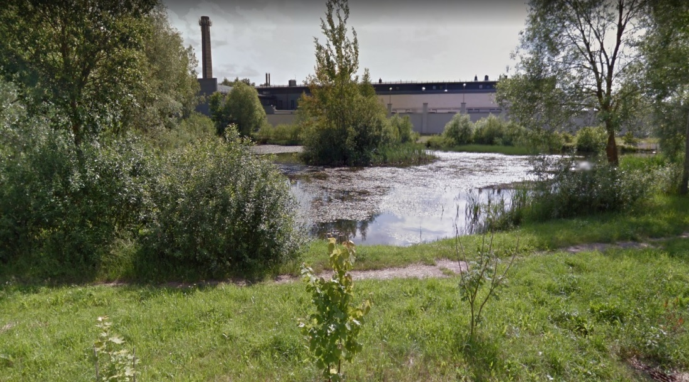
Joint Management of Urban Wetland Areas in border region Latvia-Lithuania. (Urb-Area)
Project Nr. LLI-472
Restoration of wetlands’ green infrastructure
Based on recommendations of experts
Removal of excess water plant,
bottom cleaning,
sludge removal
Pond in Daugavpils Latgale Zoo area
Green pond in Anyksciai
www.anyksciai.lt
www.daugavpils.lv

Slide 9
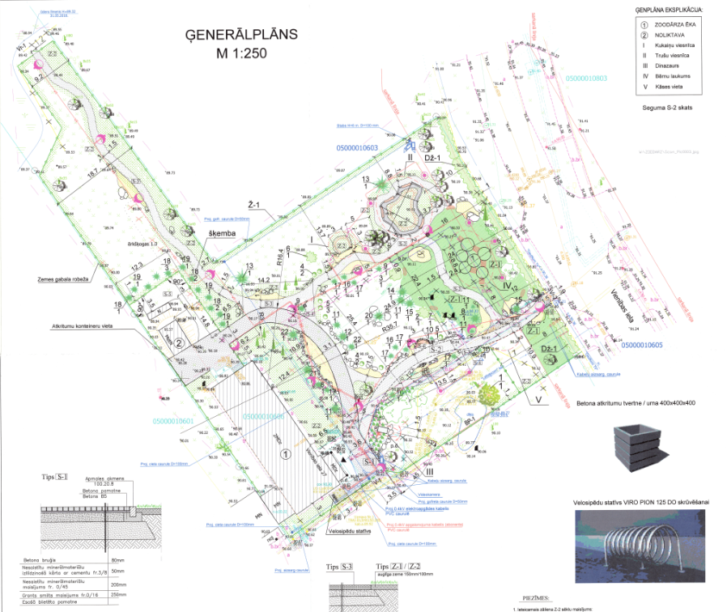
Joint Management of Urban Wetland Areas in border region Latvia-Lithuania. (Urb-Area)
Project Nr. LLI-472
Landscaping of wetlands’
adjusted territory
Daugavpils:
fence, gates, paths, benches, trash bins,
bike holder, lighting, security cameras, visitor counter
Anyksciai:
paths, benches, trash bins, floating fountain,
bike holder, visitor counter
www.anyksciai.lt
www.daugavpils.lv

Slide 10
Joint Management of Urban Wetland Areas in border region Latvia-Lithuania. (Urb-Area)
Project Nr. LLI-472
Joint on-line management system On-line application
Indoor screen
in Daugavpils
Latgale Zoo
Indoor screen
in Anyksciai
In Tourism and business information center
10 in Daugavpils wetland
Operational Server and video archive
in Daugavpils
10 in Anyksciai wetland
20 bird watching wireless water protected cameras with solar batteries
installed on plastic pontoons in urban wetlands
www.anyksciai.lt
www.daugavpils.lv

Slide 11
Joint Management of Urban Wetland Areas in border region Latvia-Lithuania. (Urb-Area)
Project Nr. LLI-472
Joint on-line management system
Life bird watching in Daugavpils
Life bird watching in Anyksciai
Archive for best videos
Electronic catalogue
of wetlands’ biodiversity
Pictures, video, description
in ENG, LT, LV
Developed software
&
Homepage adjustable
also for mobile phones
&
Indoor touch screens
Interactive Eco-educational materials
and games in ENG, LT, LV
Joint Action Plan
On-line consultations with experts
www.anyksciai.lt
www.daugavpils.lv

Slide 12
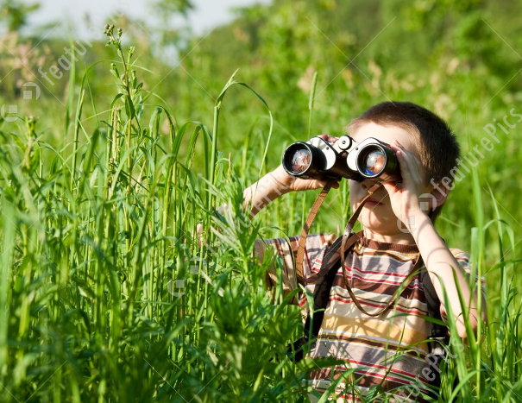
Joint Management of Urban Wetland Areas in border region Latvia-Lithuania. (Urb-Area)
Project Nr. LLI-472
Partner workshops and round-table discussions,
educational events
Binocular
hydroscopes
telescopes
Partner workshops
Experts discuss Joint Action Plan
Round table discussions
Experts and responsible municipal specialists discuss issues of urban wetlands management
Eco educational activities
Experts for children and general public presents raise awareness of environmental risks
Daugavpils February 2021 / Anyksciai Augusts 2021
20 participants per event
Daugavpils October 2021 / Anyksciai April 2022
50 participants per event
4 in Daugavpils July 2022 / 4 in Anyksciai July 2022
25 participants per event
www.anyksciai.lt
www.daugavpils.lv

Slide 13
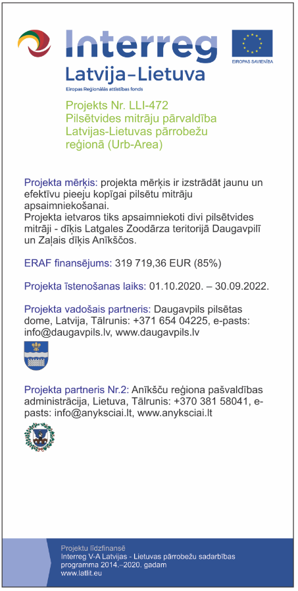
Joint Management of Urban Wetland Areas in border region Latvia-Lithuania. (Urb-Area)
Project Nr. LLI-472
Informative posters at PP’s premises
Daugavpils City Council, LV
Latgale Zoo, LV
Anyksciai District Municipality Administration, LT
Anyksciai Antanas Vienuolis Progymnasium, LT
(A 3)
Publicity / Communication
Press releases
4 press releases -> www.daugavpils.lv
4 press releases -> www.anyksciai.lt
- at the beginning of project
- after producing the Joint Action Plan
- after completing the improvement work on project sites
- at the end of the project
Project section on PP’s websites
1-> www.daugavpils.lv
1-> www.anyksciai.lt
Marking of premises equipped by the project
Latgale Zoo, LV
Anyksciai Antanas Vienuolis Progymnasium, LT
Project information on Programme website
www.latlit.eu
Marking of investments into infrastructure
Latgale Zoo area, LV
Anyksciai Green pond area, LT
Newspaper articles
2 in local or regional newspaper in Latvia
2 in local or regional newspaper in Lithuania
- after producing the Joint Action Plan
- at the end of the project
Video-clips
1-> Daugavpils
1-> Anyksciai
PP2 Budget
Informative posters
1 roll_up -> Daugavpils
1roll_up -> Anyksciai
Permanent plaques
on project sites no later than 3 months after finalization of improvement works
1 -> Latgale Zoo, LV
1 -> Anyksciai Green pond area, LT
www.anyksciai.lt
www.daugavpils.lv

Slide 14
Joint Management of Urban Wetland Areas in border region Latvia-Lithuania. (Urb-Area)
Project Nr. LLI-472
Project periods / Reporting periods
Period 1
01.10.2020–31.03.2021
Period 2
01.04.2021–30.09.2021
Period 3
01.10.2021-31.03.2022
Period 4
01.04.2022-30.09.2022
Report for Period 1 -> EMS
2 weeks from the end of reporting period
Dead line - 14.04.2021
FC verification and issuing of FC certificates
2-2,5 months from the end of reporting period
-> 15.06.2021
Consolidated Report for Period 1 -> EMS
2 weeks after receiving the FC certificates
~ Dead line - 30.06.2021
1st Payment
(of 70% reported eligible ERDF costs) to LP
2 weeks after Consolidated Report for Period 1 received -> 15.07.2021
2nd Payment
(of 30% reported eligible ERDF costs) to LP
2 weeks after Consolidated Report for Period 1 approved -> 30.09.2021
www.anyksciai.lt
www.daugavpils.lv

Slide 15
Joint Management of Urban Wetland Areas in border region Latvia-Lithuania. (Urb-Area)
Project Nr. LLI-472
Thank You for Your time!
Olga Tolmacova
Head of the office for strategic planning and international affairs
of Development department
at Daugavpils City Council
+371 20089634
Olga.tolmacova@daugavpils.lv
www.anyksciai.lt
www.daugavpils.lv

